Slide 1
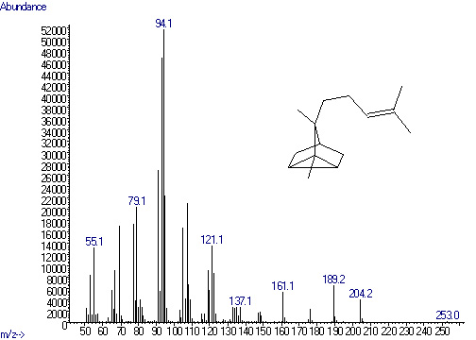
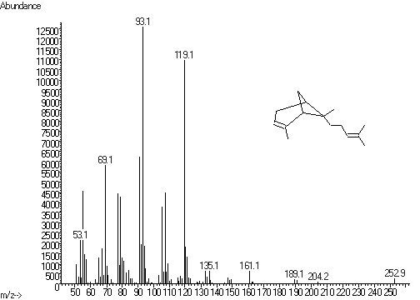
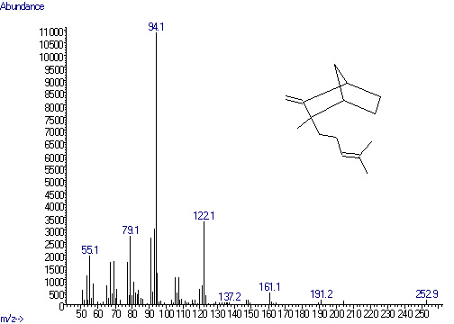
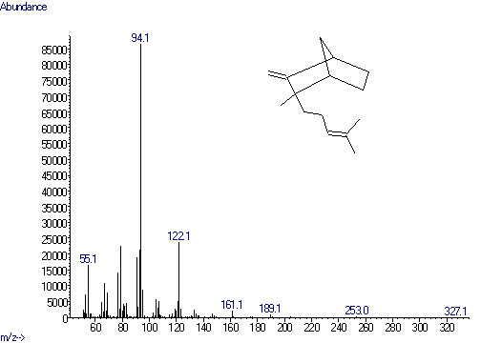
1
HS6
2
4
2
3
5
α-Santalene
S4
3
α-Bergamotene
Relative abundance ×10⁶
RTPFS8
4
WT
Epi-β-Santalene
HSP1
5
β-Santalene
Retention time (min)
S3 Fig. GC–MS chromatograms of transgenic Nicotiana tabacum headspace volatiles. RTP, A. thaliana ribulose bisphosphate carboxylase small subunit transit peptide; SaSSy, Santalum album santalene synthase; FPS, A. thaliana farnesyl diphosphate synthase; HMGR, A. thaliana 3-hydroxy-3-methylglutaryl-CoA reductase; SaCYP76F39v1, Santalum album santalene/bergamotene oxidase(CYP76F39v1). EF1A-1 was control gene; WT, wild type; S, the transgenic lines expressing SaSSy; RTPFS, the transgenic lines expressing RbcSTP-FPS + RbcSTP-SaSSy; tHS, the transgenic lines expressing tHMGR + SaSSy; HS, the transgenic lines expressing HMGR + SaSSy; HSP, the transgenic lines expressing HMGR + SaSSy + SaCYP76F39v1. The peak 1, 2, 3, 4 and 5 correspond to camphor (Internal Standard), α-santalene, α-bergamotene, epi-β-santalene, β-santalene, respectively.

